Slide 1
The genomics facilitator’s toolkit
NTGLH Module ID | Module Title | Module Format
NTGHL_001 | NHS Genomic Medicine Service | Handbook
NTGHL_002 | Ordering from the National Test Directory | Handbook
NTGHL_003 | Whole Genome Sequencing consent | Handbook
NTGHL_004 | Whole Genome Sequencing sample requirements | Handbook
NTGHL_005 | Clinical genetic testing methods | Powerpoint with narration
NTGHL_006 | Clinical testing DNA sequence variant interpretation | Powerpoint with narration
NTGHL_007 | Whole Genome Sequencing results | Powerpoint with narration
NTGHL_008 | Introduction to genomics | Powerpoint with narration
NTGHL_009 | Test cases in cancer | Handbook

Slide 2
NTGHL005 Clinical genetic testing methods
Information for healthcare professionals
Notes:
Published 14/10/2020. Content is current at time of publication. Contact your GLH test provider for current GMS test forms.

Slide 3
Methodologies
National Health Service England (NHSE) National Test Directory (TD) ‘genetic’ testing methodologies are grouped broadly into two categories depending on the type of abnormality being measured:
Cytogenetic - detect abnormalities in chromosome structure
Molecular - detect abnormalities in DNA sequence.

Slide 4
cytogenetic
molecular
Notes:
Cytogenetic - detect abnormalities in chromosome structure
Molecular - detect abnormalities in DNA sequence.

Slide 5
TD test methods
Genetic test type | Genetic test method | Example
Cytogenetics | DNA repair defect (breakage) | Nijmegen breakage
Cytogenetics | Fluorescent in situ hybridization (FISH) | EWSR1 rearrangement
Cytogenetics | Karyotype | Disorders of sexual development/infertility
Cytogenetics | Chromosomal microarray analysis (CMA) | Developmental delay/learning difficulties
Cytogenetics | Quantitative fluorescence PCR (QF-PCR) | Haematological tumour, RUNX1-RUNX1t1
Molecular | Complex targeted variant¹ | Haematological tumour, BCR-ABL1 TKD seq
Molecular | Identity | Identity
Molecular | Methylation^{2,3} | X-inactivation
Molecular | Microsatellite instability² | Solid tumour MSI testing
Molecular | Multiplex ligation-dependent probe amplification (MLPA)² | Prader-Willi syndrome
Molecular | Non-invasive prenatal genetic diagnosis (NIPD)³ | NIPD for cystic fibrosis
Molecular | Single gene/(simple) targeted variant sequencing¹ | Neutropenia consistent with ELANE mutations
Molecular | Small panel³ | Sarcoma multi-target, H3F3A, H3F3B, IDH1, IDH2
Molecular | Small Tandem Repeat (STR)¹ | Fragile X
Molecular | uniparental disomy (UPD)² | Prader-Willi syndrome
Molecular | Whole exon sequencing (WES) or large panel³ | Hypertrophic cardiomyopathy
Molecular | Whole genome sequencing (WGS)³ | Eligible rare disease or cancer
Notes:
The above table summarises the majority of the genetic testing methods offered by the NHSE TD. Examples have been drawn from both the TDs for rare disease and cancer.
¹ PCR technology - polymerase chain reaction
² Ligation mediated PCR - e.g., MLPA
³ NGS - next generation sequencing

Slide 6
Cytogenetic methods detect abnormalities in chromosome structure

Slide 7
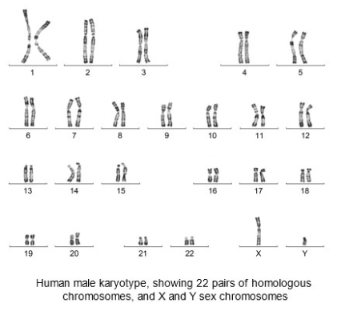
Karyotyping
Genome-wide image of
chromosomes’ banding pattern
Used when cultured cells are available
In ideal conditions aberrations as small as 5 Mb can be detected
Provides a way of screening the whole genome for genetic deletions, duplications and rearrangements
Primary tool for analysing patients with a variety of congenital anomalies.
Notes:
https://www.genomicseducation.hee.nhs.uk/glossary/karyotype/
NHSE HEE - Inheriting genomic information
PMID: 12197695
Clinical cytogeneticists analyse human karyotypes to detect gross genetic changes; DNA abnormalities involving lengths of several megabases or more.
A hybridisation method.
Visualised using light microscopy, an image of chromosomes is presented in their pairs from largest to smallest.
Blood samples give the best quality chromosomes and therefore provide the best chance of detecting small subtle chromosome abnormalities.
For karyotyping, blood cultures are grown and harvested to yield metaphase cells that are analysed using light microscopy. This is the stage of the cell cycle where the chromosomes are in their characteristic condensed, discrete shape.
Karyotypes are prepared using standardised staining procedures that reveal characteristic structural features for each chromosome. Standard G-banding (Giemsa, Leishman's or variant) produces a banding pattern characteristic of each individual chromosome.
Used for aneuploidy (the presence of an abnormal number of chromosomes in a cell, which can be more or fewer than the normal number) conditions and to identify abnormities including deletions, duplications or translocations of large sections of chromosomes.

Slide 8
Fluorescence in situ hybridization (FISH)
Genome-wide image of labelled probes mapped to specific DNA sequences of chromosomes
Can detect much smaller chromosomal abnormalities than karyotyping - 100 Kb-1 Mb
Requires in vitro cultured cells but a much smaller sample than karyotyping - even down to a single cell
Provides a way of screening the whole genome for genetic deletions, duplications and rearrangements
Primary tool for analysing patients with specific microdeletion syndromes and sub-telomere screening
Notes:
Clinical cytogeneticists use FISH testing for the mapping and quantitation of chromosomes, genes and specific portions of genes, including aneuploidy , chromosomal deletions, amplifications and translocations.
A hybridisation method.
Technique uses single stranded DNA/RNA probes short in sequence labelled with fluorescent dye that complement a portion of the gene of interest. When a probe binds to a chromosome the fluorescent tag allows visualisation of its location/positional mapping.
FISH has a higher resolution than karyotyping, abnormalities at about 100kb-1Mb in size can be detected. FISH can only detect deletions or duplications of regions specifically targeted by the probe used and that are larger than the probe used. It is possible that rare very small deletions may not be detected by FISH.
For FISH testing interphase nuclei are required, this is a DNA replication stage allowing FISH probes to bind.
Use for microdeletion syndromes. For example, DiGeorge syndrome (22q11 del) and Williams syndrome (7q11.2 del, includes Elastin gene). Also used for sub-telomere screening; small rearrangements involving the ends of chromosomes. For example, in individuals with dysmorphology and/or congenital malformations, in addition to neurodevelopmental symptoms such as mental retardation.

Slide 9
Fluorescent in situ hybridization (FISH)

Slide 10
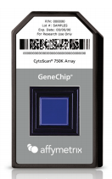
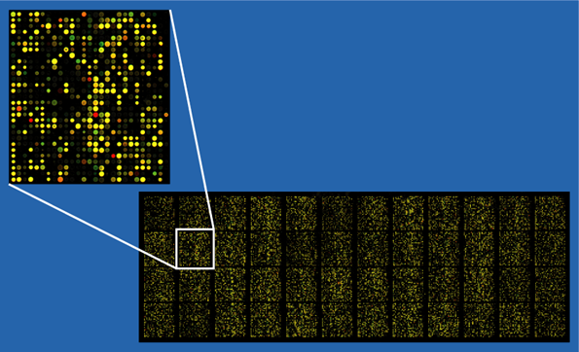
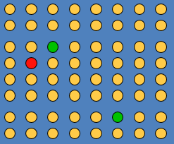
Chromosomal microarrays analysis (CMA)
A
B
C
Genome-wide chromosome test
Provides information on how much genetic material is present, not an image of where it is
Does not require cultured cells
Can detect much smaller chromosomal abnormalities than karyotyping and FISH; can detect abnormalities as low as 10 Kb
Limitation: will not pick up balanced translocations
First line analysis for developmental delay, intellectual disability, congenital defects.
Notes:
A. microarray chip; B. processed microarray; C. orange, equal DNA, normal copy number; green, excess patient DNA, copy number amplification; red, excess control DNA, copy number deletion.
Chromosomal microarrays compare the patient’s genome against a reference genome (normal control or a standard) to identify differences (regions of genomic imbalance) between the two genomes.
A microarray is a chip that contains DNA sequences specific to the type of variation that is being examined.
A hybridisation method.
Similar to FISH, chromosomal microarrays use sequence-based probes to analyse the expression of thousands of regions of the genome. It is particularly useful to look for copy number variants that may be missed using other genomic technologies. Chromosomal microarrays can identify regions with absence of heterozygosity (AOH), indicating conditions caused by uniparental disomy.
Commonly microarrays that are used for clinical CMA testing include thousands to millions of sequence probes that span the length of every chromosome. Microarrays may also incorporate sequence probes that specifically target chromosomal regions known to cause an abnormal phenotype. Microarrays also include single nucleotide polymorphic (SNP) probes and nonpolymorphic probes to enable consistent genomic coverage.
Also referred to as: Array Comparative Genomic Hybridisation (CGH), biochip, DNA chip.
Microarrays can also be used for single nucleotide variant genotyping.
A limitation of this test is that it will not detect balanced translocations.
There are two types of translocation: reciprocal and Robertsonian. In reciprocal translocations, material is swapped between two different chromosomes. Robertsonian translocations are caused by breaks that occur at or near the centromere on acrocentric chromosomes, resulting in the long arm of one chromosome fusing with another.
Chromosomes 13, 14, 15, 21 and 22 are acrocentric, which means that the centromere is not central and near the end of the chromosome.

Slide 11
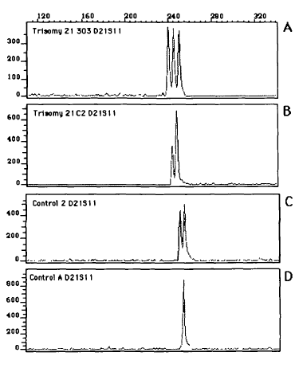
Quantitative fluorescence PCR (QF-PCR)
A targeted aneuploidy test. Is commonly used for specific-variant testing (i.e. abnormality previously identified in blood relatives)
Does not require in vitro cultured cells; uses various sample types
Information on how much genetic material is present, not an image of where it is
Limitation: does not detect structural abnormalities
QF-PCR commonly assesses a number of locations on chromosomes 13, 15, 16, 18, 21, 22, X and Y; the commonest trisomies found in pregnancy losses.
Notes:
Image sourced from PMID: 8490622
Method used to PCR amplify specific regions of DNA on a chromosome to quantify the amount of DNA present in those regions.
QF-PCR primers are fluorescent labels target and amplify regions of small tandem repeats (STRs). STRs can vary in length in individuals. A normal diploid sample has a contribution from two STRs (one from each parental chromosome). When the STRs are different in size (heterozygous) they give an informative result. When they are the same size (homozygous) the result is not informative, or it may indicate monosomy.
Chromosomal analysis method when cultured cells are not available and provides a rapid response alternative to karyotyping.

Slide 12
Molecular methods detect abnormalities in DNA sequence

Slide 13
Molecular methods
Molecular technologies are broadly grouped into three approaches:
Polymerase chain reaction (PCR)
Ligation mediated PCR e.g. MLPA
Next Generation Sequencing (NGS).

Slide 14
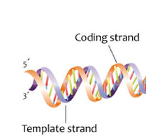
Polymerase chain reaction (PCR)
Denature
Anneal
Extend
Amplified target of interest, two copies
PF PR
Genome target of interest
Polymerase chain reaction, or PCR, is a laboratory technique used to amplify/make multiple copies of a segment of DNA. Template DNA is denatured into single strands. Forward (PF) and reverse (PR) primers anneal. An extension step leads to amplified/copies of the original target of interest.

Slide 15
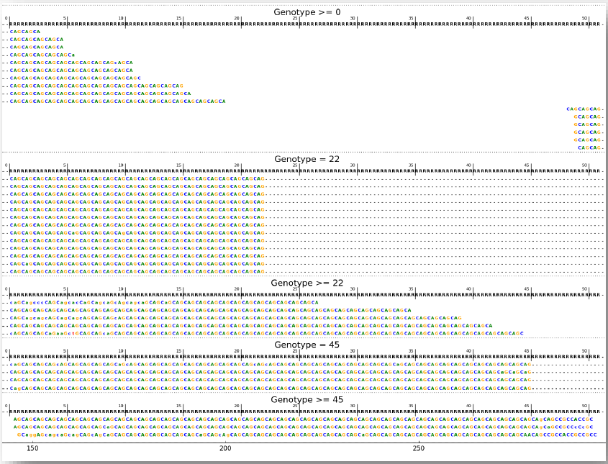
Examples of PCR sequence-based tests
Microsatellite-based testing
CTT
CTT
CTT
CTT
CTT
CTT
CTT
0 +3 bases
Microsatellite length
Huntington disease is a progressive brain disorder caused by a pathogenic microsatellite CAG-repeat motif. An individual with CAG₃₆₋₃₉ may or may not develop symptoms of Huntington disease, whilst people with 40 or more CAG (CAG₄₀₊) repeats almost always develop the disorder.
Genomics England Rare Disease Results Guide
Notes:
What are microsatellites?
Stretches of DNA containing core repeat ‘motifs’ typically between two and seven bases in length that are tandemly repeated. The microsatellite and its flanking DNA sequence are amplified by PCR and subsequent analysis looks at the length (number of tandem repeats) of the microsatellites targeted, which can be visualised as graphical peaks or sequence alignments. In the top figure the microsatellite is a CTT tri-nucleotide, which on one allele is repeated four times and the other allele three times. This is visualised graphically as two peaks three bases apart. Analysis identifies whether an individual has a normal or pathogenic number of repeats associated with each locus.
Types of microsatellite-based tests:
QF-PCR testing, as described previously to determine aneuploidy.
Microsatellite Instability (MSI) testing targets by PCR certain DNA microsatellites. MSI is the accumulation of insertion or deletion errors at microsatellite repeat sequences. MSI leads to genetic hypermutability. For example, in cancers the presence of high levels of MSI (MSI-H) might be predictive of Lynch syndrome, a hereditary phenotype with increased cancer risk across a variety of tumour types. MSI-H tumours are also potentially more sensitive to immune checkpoint inhibitor treatments than microsatellite-stable (MSS) tumours.
Short Tandem Repeats (STR) testing is based on the same molecular principle as QF-PCR/MSI testing, as a STR is a microsatellite amplified by PCR. Examples of STR-based testing are given under “STR” on https://panelapp.genomicsengland.co.uk/panels/entities/. An example of Huntington disease is described above and in the bottom figure.

Slide 16
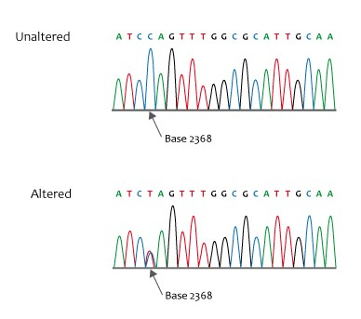
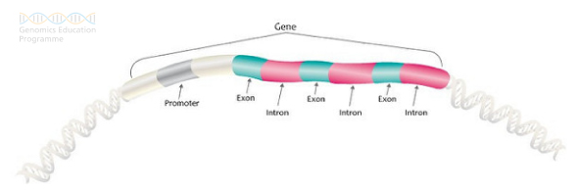
Examples of PCR sequence-based tests
Targeted and single gene testing
Sequence chromatogram
Notes:
PCR amplification with Sanger sequencing determines the per base sequence of DNA. Targeted sequence – typically up to 400 bases – and whole gene testing is often used when a known genotype is suspected of causing the phenotype of interest, for carrier testing or specific mutation testing, and for genetic regions associated with therapeutic response or regions that influence the likelihood of disease.
PCR amplification with electrophoresis and staining can also be used for complex target testing, such as gene rearrangement analysis.
Gene sequencing typically targets the protein coding region (exon(s)) only.
A chromatogram (or electropherogram) is the visual representation of a DNA sequence often processed by a machine such as Applied Biosystems ABI PRISM Sequence Detection System. Top right.
A nonsense mutation occurs when a DNA base alteration leads to the appearance of a stop codon where previously there was a codon specifying an amino acid. This premature stop codon results in the production of a shortened, and likely nonfunctional, protein. Such variants that lead to protein truncation can be disease causing. (Bottom right)

Slide 17
Ligation mediated PCR Multiplex Ligation-dependent Probe Amplification (MLPA)
The MLPA reaction can be divided into five steps:
DNA denaturation and probe hybridisation
Ligation reaction
PCR amplification
Separation of amplification products by electrophoresis
Data analysis.
Notes:
Multiplex Ligation-dependent Probe Amplification (MLPA)
This technique is able to analyse, in a single reaction, up to 50 DNA sequences and is used to detect copy number variation of specific genes, including small intragenic rearrangements.
This multiplex PCR assay utilises probes, each specific for a different DNA sequence (mainly exons of a specific gene of interest), to evaluate the relative copy number of each DNA sequence.
Each probe is composed of two half-probes (5′ and 3′ half-probes), consisting of a target-specific sequence and a universal primer sequence allowing the simultaneous multiplex PCR amplification of all probes. In addition, one or both half-probes contain a stuffer sequence allowing differentiation during electrophoresis of the length of the probe itself, and, as a consequence, the size of the amplification product.

Slide 18
Genomic imprinting and uniparental disomy disorders tested by MLPA
Clinical Indication | Target Regions/Genes
Angelman syndrome | AS/PWS critical region
Prader-Willi syndrome | AS/PWS critical region
Hypotonic infant with a likely central cause | SNRPN DMR
Growth failure in early childhood | 11p15 imprinted growth regulatory region and UPD7 growth regulatory critical region
Beckwith-Wiedemann syndrome | 11p15 imprinted growth regulatory region
Isolated hemihypertrophy or macroglossia | 11p15 imprinted growth regulatory region
Temple syndrome - maternal uniparental disomy 14 | UPD14 critical region
Kagami-Ogata syndrome - paternal uniparental disomy 14 | UPD14 critical region
Albright hereditary osteodystrophy, pseudohypoparathyroidism and pseudopseudohypoparathyroidism | GNAS DMRs
Wilms tumour with features suggestive of predisposition | 11p15 imprinted growth regulatory region
Notes:
The TD includes a number of genomic imprinting disorders that can be tested using MLPA methods. The table above gives examples of these and the target regions/genes.
Heritable changes are not only limited to changes (small or large (copy number/structural)) in the primary DNA sequence, but also changes to gene expression/regulation (epigenetic). The best understood epigenetic mechanisms include CpG DNA methylation and histone modification; both involve addition of functional groups by covalent bonding. These epigenetic mechanisms have a role in gene activity involved in normal development, therefore errors in normal epigenetic function can cause disease.
Genomic imprinting is an epigenetic phenomenon that causes genes to be expressed in a parent-of-origin-specific manner. People inherit two copies of each gene - one from their mother and one from their father (except for the male y-sex chromosome). Usually both copies of each gene are active, or “turned on,” in cells. In some cases, however, only one of the two copies is normally turned on. Which copy is active depends on the parent of origin: some genes are normally active only when they are inherited from a person’s father; others are active only when inherited from a person’s mother. (https://ghr.nlm.nih.gov/primer/inheritance/updimprinting). Two major clusters of imprinted genes have been identified in humans, one on the short (p) arm of chromosome 11 (at position 11p15) and another on the long (q) arm of chromosome 15 (in the region 15q11 to 15q13).
There are a number of epigenetic molecular methods that can be separated into three categories: global methylation, local methylation and genome-wide methylation. For a review see: https://www.labome.com/method/DNA-Methylation.html

Slide 19
Notes:
Table sourced from PMID: 22489151

Slide 20
Next generation sequencing
Genome
Genome fragmented
Prepare sample - DNA modified and amplified.
Reference genome
Sequencing by synthesis - nucleotide added one at a time, using template. Each nucleotide addition is ‘excited’, emitting light specific to the nucleotide (A,C,G.,T) and imaged. Image converted to a sequence
Data analysis - all fragments aligned against a reference genome. Variants against reference identified.
Cluster generation - results in clonal amplification of all fragments.
Notes:
Illumina sequencing by synthesis (5:12 min), https://www.youtube.com/watch?v=fCd6B5HRaZ8
Basic illustration of Next Generation Sequencing (2:10 min), https://www.youtube.com/watch?v=2JUu1WqidC4

Slide 21
Types of NGS sequencing
Whole genome sequencing (WGS) - sequencing all of the genome.
Whole exome sequencing (WES) - targets all known protein genes that represent less than 2% of the genetic code, but contains ~85% of known disease-related variants.
Clinical exome - targets genes known to be disease causing. For example, GOSHome targets ~ 6000 genes.
Targeted clinical exome - targets specific disease causing genes for the phenotype(s) in question. For example, skeletal panel of GOSHome includes 240 genes where variants can cause skeletal anomalies.
Small panel - targets (usually) ten to 100 or more disease causing genes.

Slide 22
Alignment, depth of coverage, variant
Reference genome
A
A
A
T
T
T
T
T
Aligned sequence reads
T
T
T
T
T
T
T
T
T
Heterozygote
Error
Homozygote
Notes:
Aligned sequence reads: orange, forward sequence read; grey, reverse sequence read.
Some terms that are often quoted in talks on NGS:
Reference genome - a DNA sequence that is a representative example of the genome of a organism.
Alignment - arrangement of the sequences of an individual; sequences are ‘mapped’ to the reference genome based on the similarity between the two sequences.
Coverage - number of sequencing reads (depth of coverage) that have mapped to the reference genome for a given base position.
Variant - nucleotide of an individual’s sequence differs from the reference genome.

Slide 23
Depth of coverage
Notes:
Simplified figure showing depth of coverage. Bottom row “Depth” indicates the depth of coverage for each base across all reads. Highlighted base “T” has a depth of coverage of 4.

Slide 24
WES v WGS
WES
WGS
Cheaper
Majority of disease causing variants will be in the exome
Less analysis time required
Highly variable coverage
Capture info on all genome
Future proof
More reliable sequence coverage
Limited ability to interpret

Slide 25
Advice and educational resources
North Thames Genomic Laboratory Hub
Follow us: @NorthThamesGLH
Contact us at: gos-tr.norththamesglh@nhs.net
Further education (as an example)
https://www.genomicseducation.hee.nhs.uk/education/core-concepts/what-is-genomics/
https://www.yourgenome.org/topic/in-the-cell
https://www.futurelearn.com/programs/genomics-in-healthcare

Slide 26
Any questions?
Francesca Faravelli, Consultant Clinical Geneticist
Francesca.Faravelli@gosh.nhs.uk
North Thames GLH Education & Training Lead: Corinne Trim
corinne.trim@gosh.nhs.uk
Includes slides adapted from
https://www.genomicseducation.hee.nhs.uk/supporting-the-nhs-genomic-medicine-service/
https://www.england.nhs.uk/wp-content/uploads/2018/08/national-genomic-test-directory-faqs.pdf
Primary author - Shazia Mahamdallie, Senior Scientist, GOSH.
Narrated by - Dahlia Hopmeier, Genomics Clinical Fellow, GOSH.
Notes:
Published 14/10/2020. Content is current at time of publication. Contact your GLH test provider for current GMS test forms.

