Slide 1
Non-invasive Prenatal Testing (NIPT)

Slide 2
Non-invasive Prenatal Testing (NIPT)

Slide 3
Cell-free fetal DNA (cffDNA)

Slide 4
How is NIPT different from other screening blood tests?

Slide 5
How is NIPT different from invasive testing?

Slide 9
NIPT evaluative roll-out in England

Slide 10
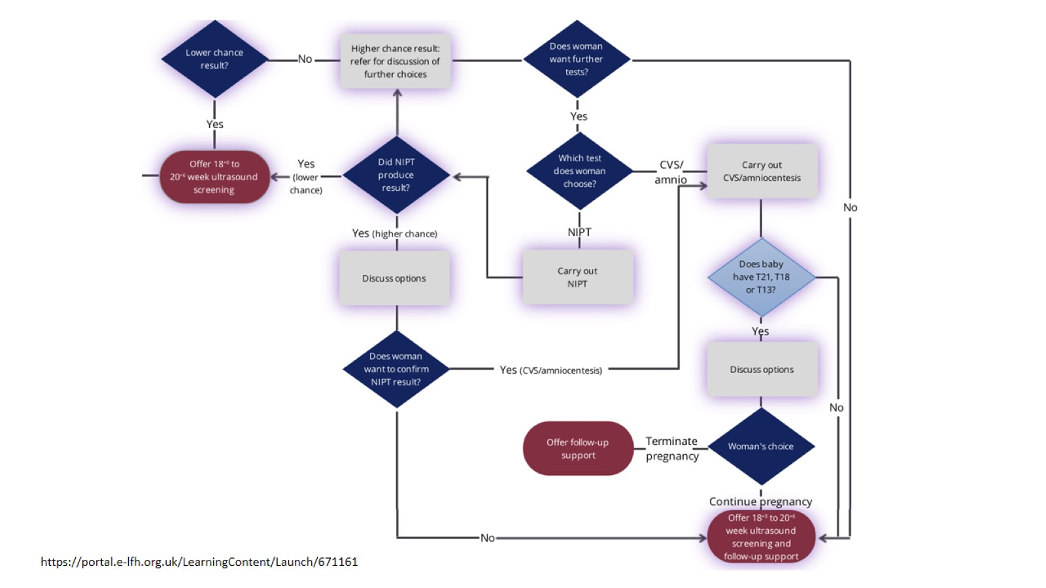

Slide 13
Limitations of NIPT

Slide 14
Exclusion criteria for NIPT

Slide 15
Pre-test counselling

Slide 16
Key Points

Slide 17
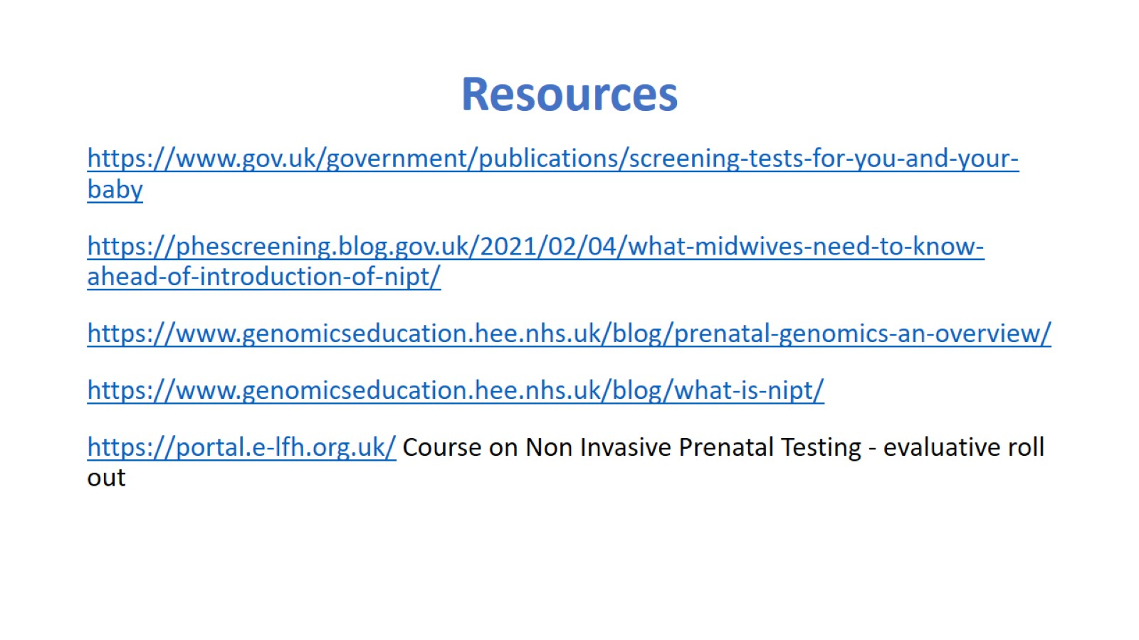
Resources

