Slide 1
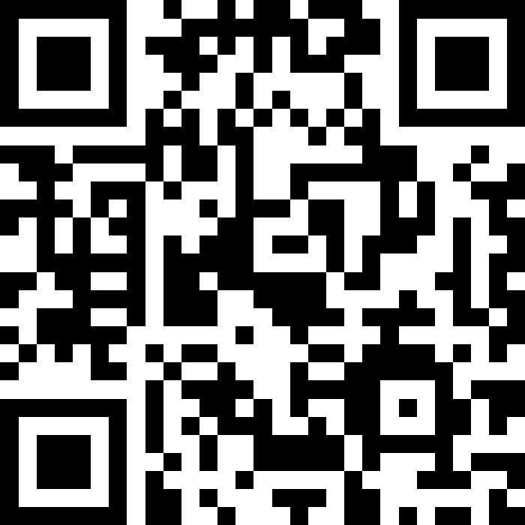
Cardiovascular Genomics Community of Practice
September 9th 2026
Slido.com #1626086
Rachel Bastiaenen, rachel.bastiaenen@nhs.net
Consultant Cardiologist and Cardiovascular Clinical Director

Slide 2
Aims of the session
Slido.com #1626086
1
Recap how to order a test and navigate our SEGMS website resources
2
Discuss the final step of the spoke pathway: interpreting results
3
Learn from colleagues in the lab, clinical genetics, and ICC centres

Slide 3
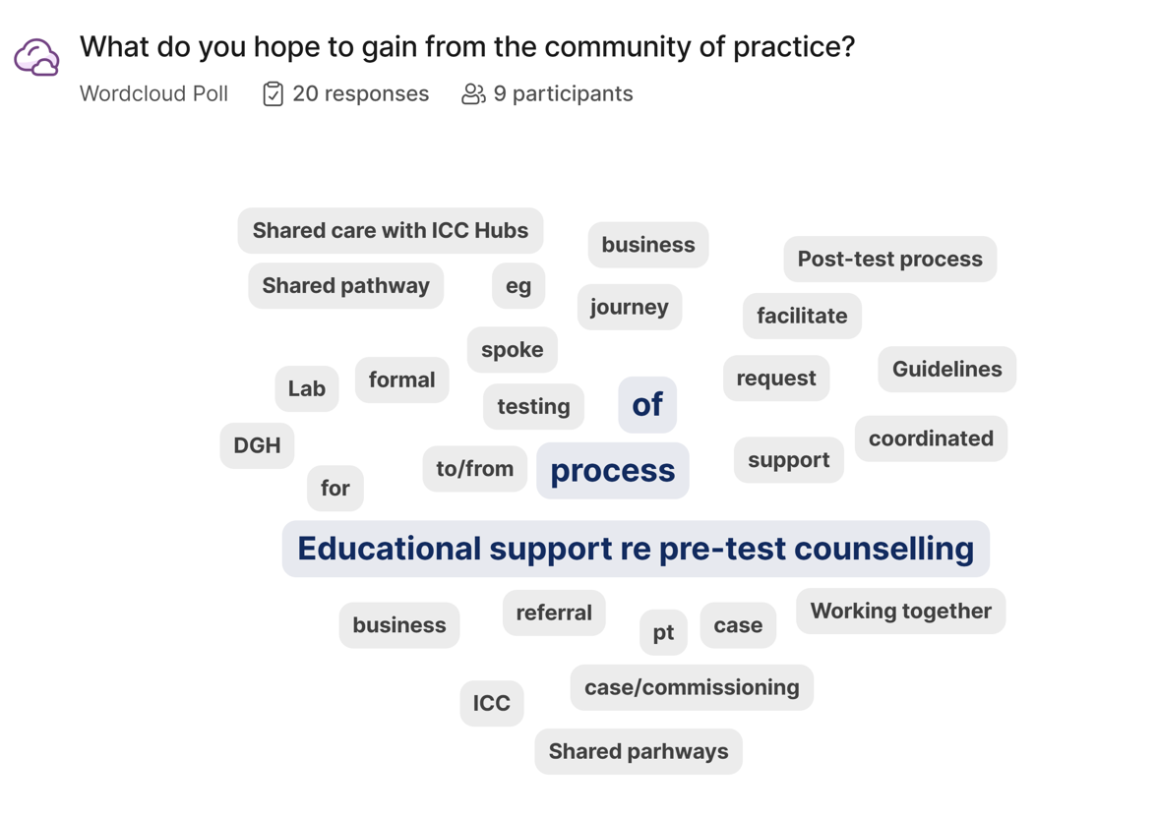

Slide 4
Do not edit
How to change the design
How would you rate your level of understanding in selecting and ordering a genomic test for a patient?
Slido.com #1626086
The Slido app must be installed on every computer you’re presenting from

Slide 5
Do not edit
How to change the design
How many tests do you order a month?
Slido.com #1626086
The Slido app must be installed on every computer you’re presenting from

Slide 6
How to order a test

Slide 7
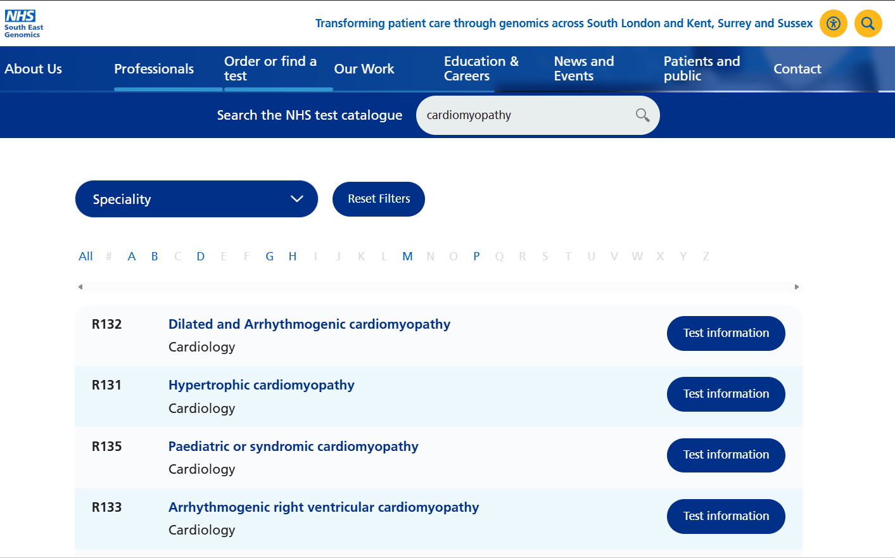
Order or find a test – filter by condition

Slide 8
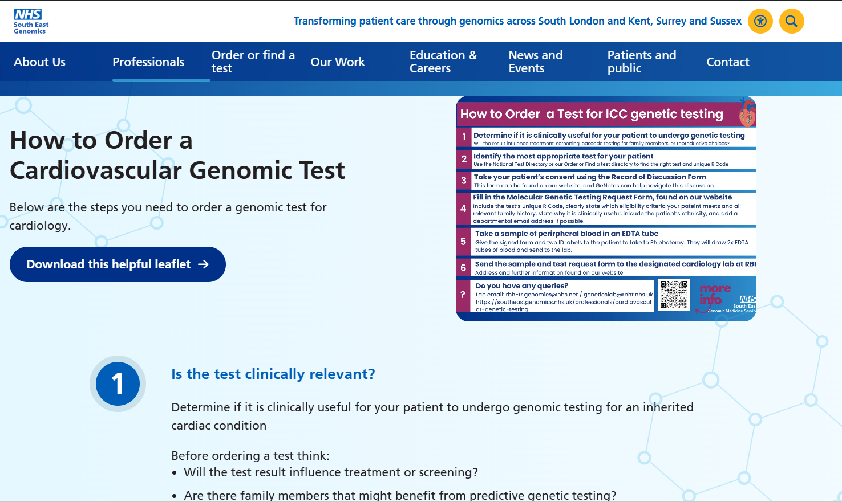
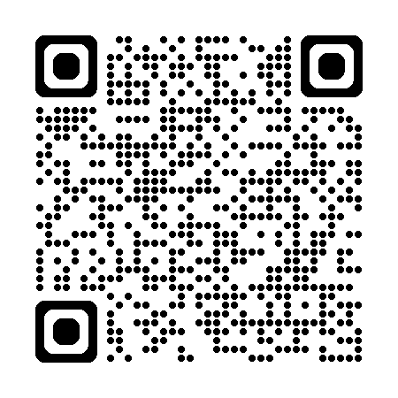

Dedicated cardio testing page
Scan the QR code to go this dedicated webpage!
Scan the QR code to download this graphic and share with your teams!

Slide 9
Development Opportunities

Slide 10
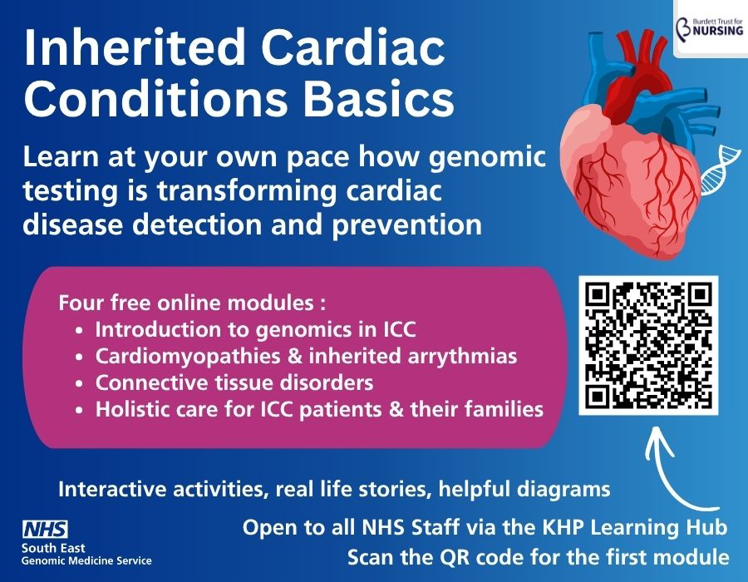
ICC Training Modules

Slide 11

Genetic Counselling Course
30-hour face-to-face course focused on counselling and communication skills for effective, time-sensitive client support.
Learn to apply practical, discipline-relevant techniques that respect clients’ values, needs, and individual circumstances.
Explore applications in individual, couple, family, and workplace settings.
Suitable for both beginners and experienced/qualified counsellors.
Choose between a 30-hour Attendance Certificate or working towards an Accredited Open Awards Certificate.
Dates: October 5,6,7,8, 2026. You must be available to attend all 4 days
Apply by 15th September 2026
Scan the QR below to apply!

Slide 12
Spoke Genetic Testing Pathway: how to interpret results

Slide 13
Standard Operating Procedure for Diagnostic Testing in Cardiomyopathies in South East GMSA Spoke ICC Services
Who to test
Review the patient's cardiomyopathy phenotype in ICC clinic
(history, exam, ECG, imaging, bloods, family pedigree, etc)
Key
Genetic Test
Pathway step
*In the instance of a familial variant of unknown significance (VUS), patients should not be tested locally and should instead be discussed in the genetics MDT and/or referred to clinical genetics (even with a clear phenotype)
Clear phenotype
Unclear phenotype (irrespective of known familial variant)
Action
Resource
Is there a known pathogenic or likely pathogenic gene variant in a first-degree relative?*
Discuss with Buddy Consultant, Advice & Guidance or Advisory Panel
or
Discuss in Regional ICC MDT for phenotype review
Notes & Guidance
** For national testing criteria use the document 'Rare and Inherited Disease Eligibility Criteria', available at:
https://www.england.nhs.uk/publication/national-genomic-test-directories
No
Yes
Referral to ICC Hub recommended after discussion
Genetic testing recommended after discussion
***Use a pre-populated Molecular Genetic Testing Request Form selection R346.1 for DNA storage (see appendix 1). Form must be signed by clincians but patient consent not required. Take patients blood in 2x labelled EDTA bottles and send to local pathology lab. This will either be sent directly to RBH GLH or via GSTT, depending on local pathway
Refer to Hub Clinical Genetics team for testing of known familial gene variant
Do they meet National Genomic Testing Directory criteria for genetic testing?**
or
No
Take blood in local clinic and send via pathology department for DNA extraction and storage in accordance with local pathway. This may be directly with GLH lab at RBH or GSTT lab. (R346.1)***
Don't test. Consider discussion in Genetics/ICC MDT if high clinical suspicion of genetic variant
Refer to Hub ICC clinic for phenotype review
Yes
Hub arranges genetic testing if appropriate
If possible, store DNA (R346.1) in ICC clinic***
Genetic testing recommended by MDT
****If there is uncertainty over which panel to test, discuss at Genetics MDT
Arrange Spoke diagnostic gene panel testing (R131, R132, R133 etc)****

Slide 14
Standard Operating Procedure for Diagnostic Testing in Cardiomyopathies in South East GMSA Spoke ICC Services
How to test
Appointment with designated HCP with training in counselling for diagnostic genetic testing
Key
Genetic Test
Pathway step
Step 1: obtain consent from the patient
- Use 'Record of Discussions' form as a template for verbal consent (see Appendix 2)
- Patient and requestor to both sign 'Record of Discussions' form, with relevant gene panel stated, and place it in the patient's notes
- Give a photocopy to the patient
Action
Resource
Notes & Guidance
- Use the 'Molecular Genetic Testing Request Form' (see Appendix 3)
- Complete the form in full with the patient, including ethnicity, phenotype and family history
- Tick the appropriate gene panel on page 2
- Fill out the 'Referrer Details', including the name and email address of the responsible consultant. The genetics result will be sent directly to them via email
- If the patient has been discussed at an MDT or with the genetics lab prior to testing, please state this on the form
- It can be helpful to add admin or secretary's email address into the "cc reports to" box for uploading of results to patient records upon receipt
- Patient and requestor should both sign the consent form at the appointment
Step 2: complete written request form
Has DNA already been stored?
Yes
No
- Give patient two ID labels and the written 'Molecular Genetic Testing Request Form' and ask them to go to phlebotomy department for blood test
- Phlebotomy department will take 2 x EDTA blood bottles and dispatch to local Pathology lab, who will arrange transfer to RBH genomics lab
- Check local Pathology policy to confirm whether specific days/timings of blood testing is required
Send the completed 'Molecular Genetic Testing Request Form' by email to gstt.RBHH.genomics@nhs.net and state "DNA previously stored"

Slide 15
Standard Operating Procedure for Diagnostic Testing in Cardiomyopathies in South East GMSA Spoke ICC Services
Interpreting results
Key
Result is emailed to responsible consultant
Please ask admin team to upload the genetics report to digital patient record
Genetic Test
Pathway step
Upload result to local genomic database
Action
Resource
Notes & Guidance
Negative test
Variant of unknown significance (VUS)
Likely pathogenic
Pathogenic
- In all cases, result should be communicated by telephone or F2F and a letter dictated, with a copy of their genetic report attached.
- In the cases of positive results, also include 'to whom it may concern' letters and enclose the genetic report (with the proband's permission) to prompt screening and predictive testing of first-degree relatives
No genetic cause for phenotype identified. Cascade genetic testing is not available for relatives
Uncertainty over phenotype-genotype correlation?
Genetic cause for phenotype not confirmed. Cascade testing not generally available for relatives. Family and/or segregation studies may sometimes be considered
- Provide 'to whom it may concern' letters for the patient to give to their first-degree relatives, so that they can be referred directly to their local cardiology/ICC service for screening tests
- Children < 16 years will need to be referred to their local paediatric cardiology service for screening. Clinical screening is advised from around 12 years old, although it depends on the individual family, gene and condition. If unsure, discuss in the genetics MDT
Yes
No
Local ICC team to inform patient
Discuss result in Regional Cardiovascular Genetics MDT
Discuss result in Regional Cardiovascular Genetics MDT
Genetic cause for phenotype confirmed. Cascade genetic testing is available for relatives
- Provide copies of the patient's genetic results letter (with their consent) and a 'to whom it may concern' letter for the first-degree relatives, so that they can be referred directly to clinical genetics via their GP
- Alternatively if the first-degree relative is already known to you, with their explicit consent you can refer them directly to clinical genetics yourself. The proband's genetic report (with their consent) must be enclosed with the referral
- If possible, send the relative's DNA for storage at the same time as referring them to clinical genetics
- If assistance is required to support cascade testing, discuss the proband at the Genetics MDT to request help with co-ordinating predictive testing referrals for first-degree relatives
- In children, referrals for predictive testing can be considered from around the age of 10-12. This varies depending on the individual family, gene and condition. If unsure discuss in the genetics MDT
- Unaffected children who are gene carriers should be referred to the Evelina or paediatric RBH ICC service for clinical screening*-+
Offer clinical screening to first degree relatives
if recommended by Genetics MDT
Local ICC team to inform patient and provide gene-specific advice and risk assessment
Local ICC team to inform patient and provide gene-specific advice and risk assessment
if recommended by Genetics MDT
Offer clinical screening to first degree relatives
and/or
Refer first-degree relatives to Clinical Genetics team at hub
Refer first-degree relatives to Clinical Genetics team at hub for predictive testing

Slide 16
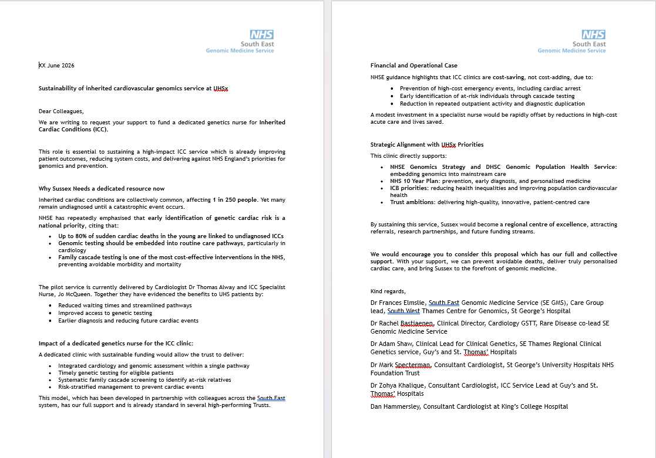
Support for you
Business case development
Patient case studies
Educational interventions

Slide 17
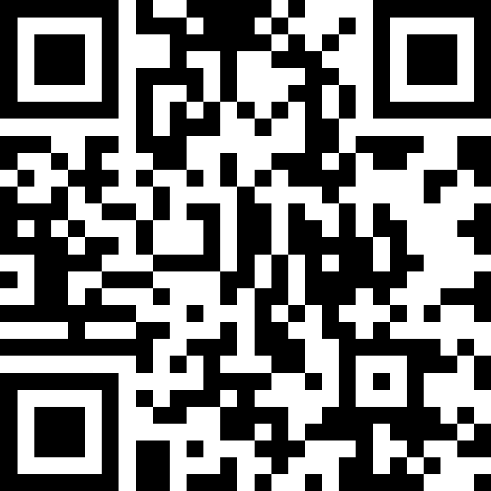
Do not edit
How to change the design
What topics or sessions would you like to have in future Communities of Practice?
Slido.com #1626086
The Slido app must be installed on every computer you’re presenting from

Slide 18
Next Up:
December 10th: Cardiovascular Genomics Community of Practice #3

Slide 19
Support & Educational Resouces

Slide 20
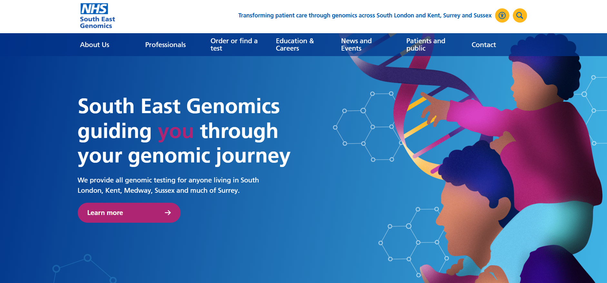

Visit our website: https://southeastgenomics.nhs.uk/

Slide 21
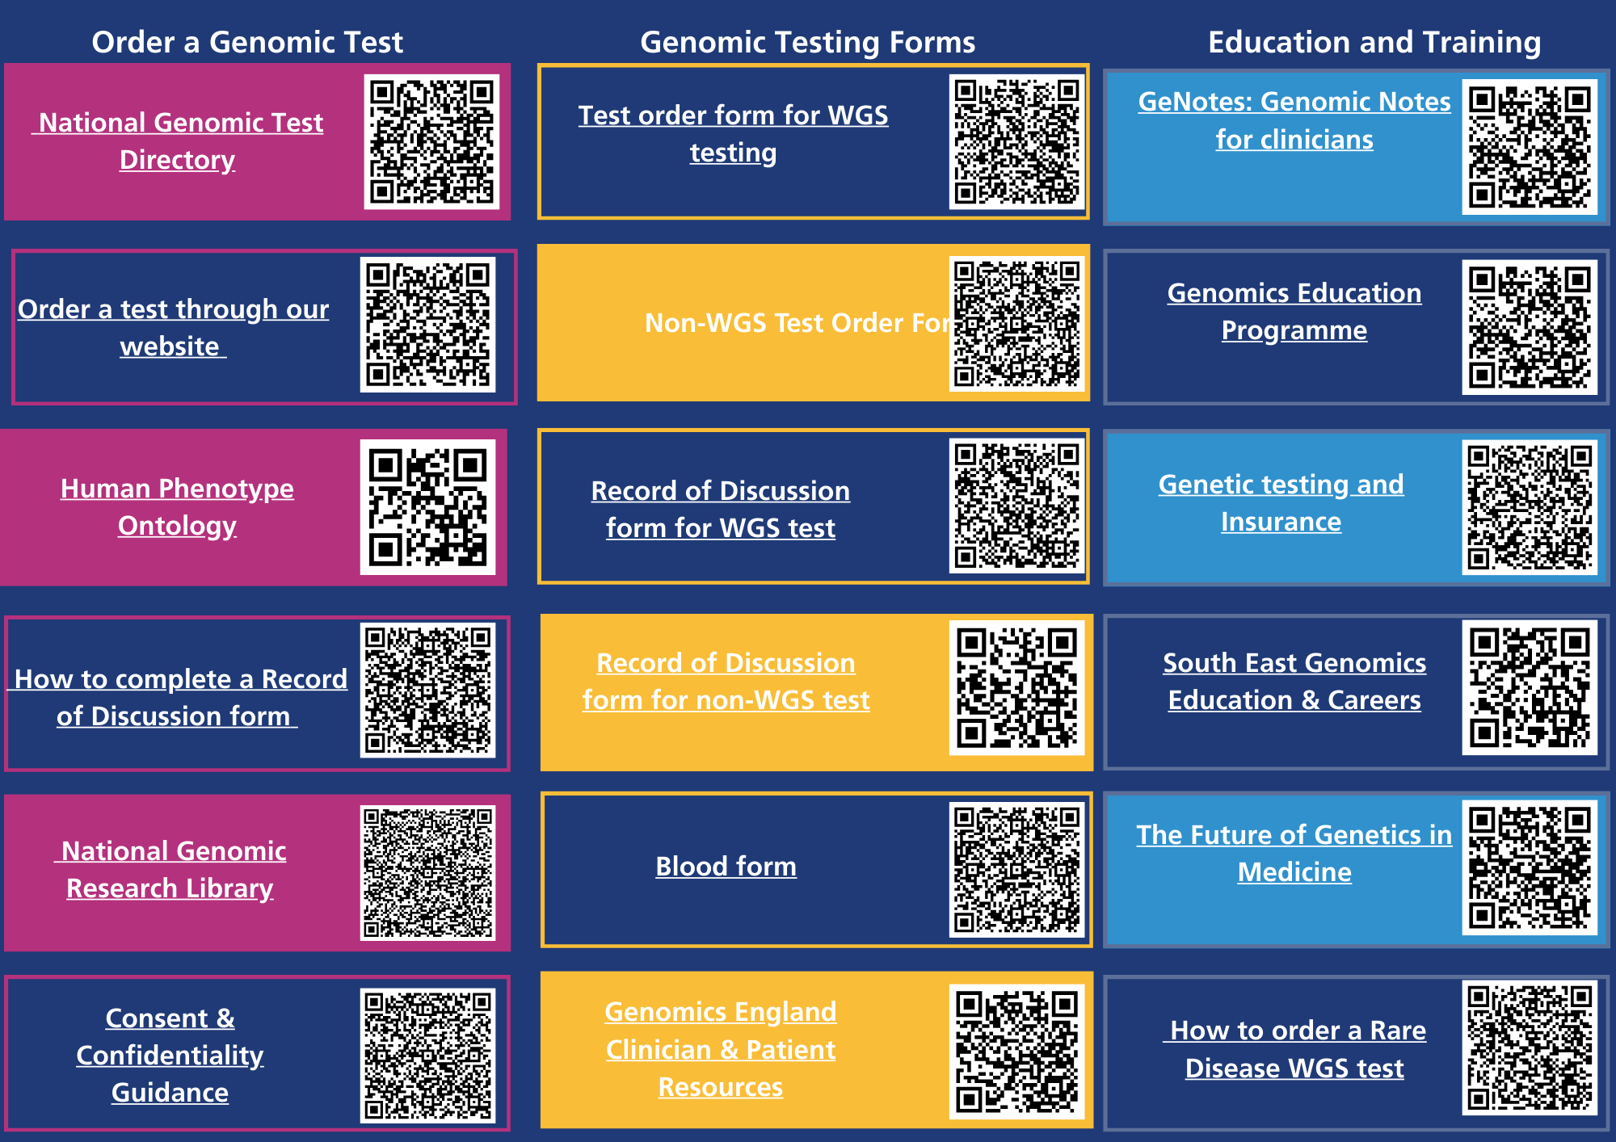
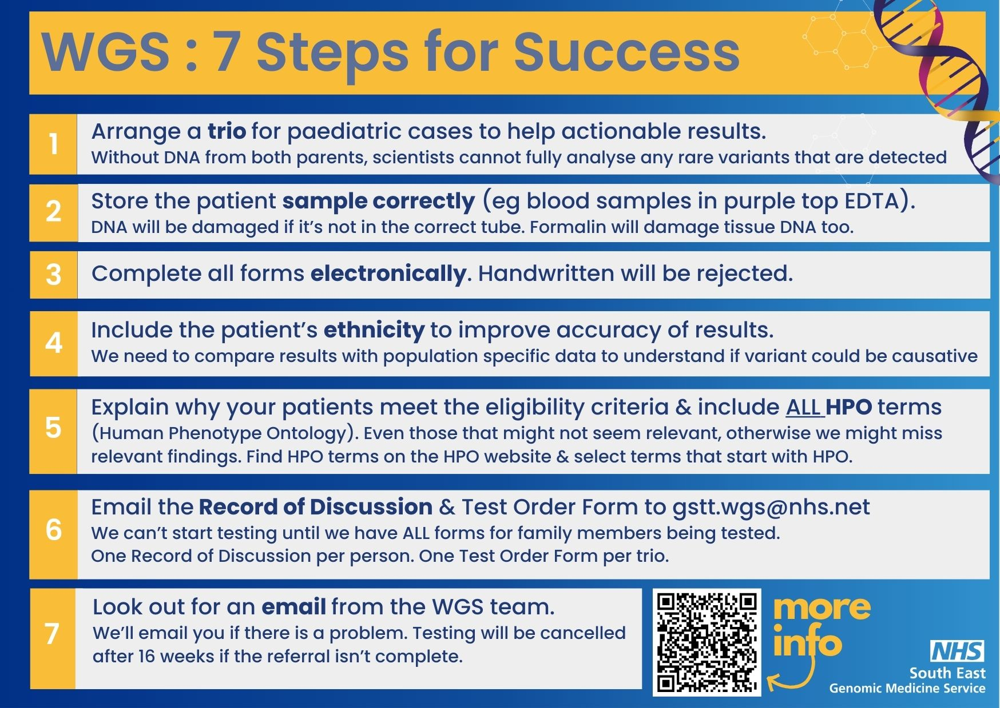
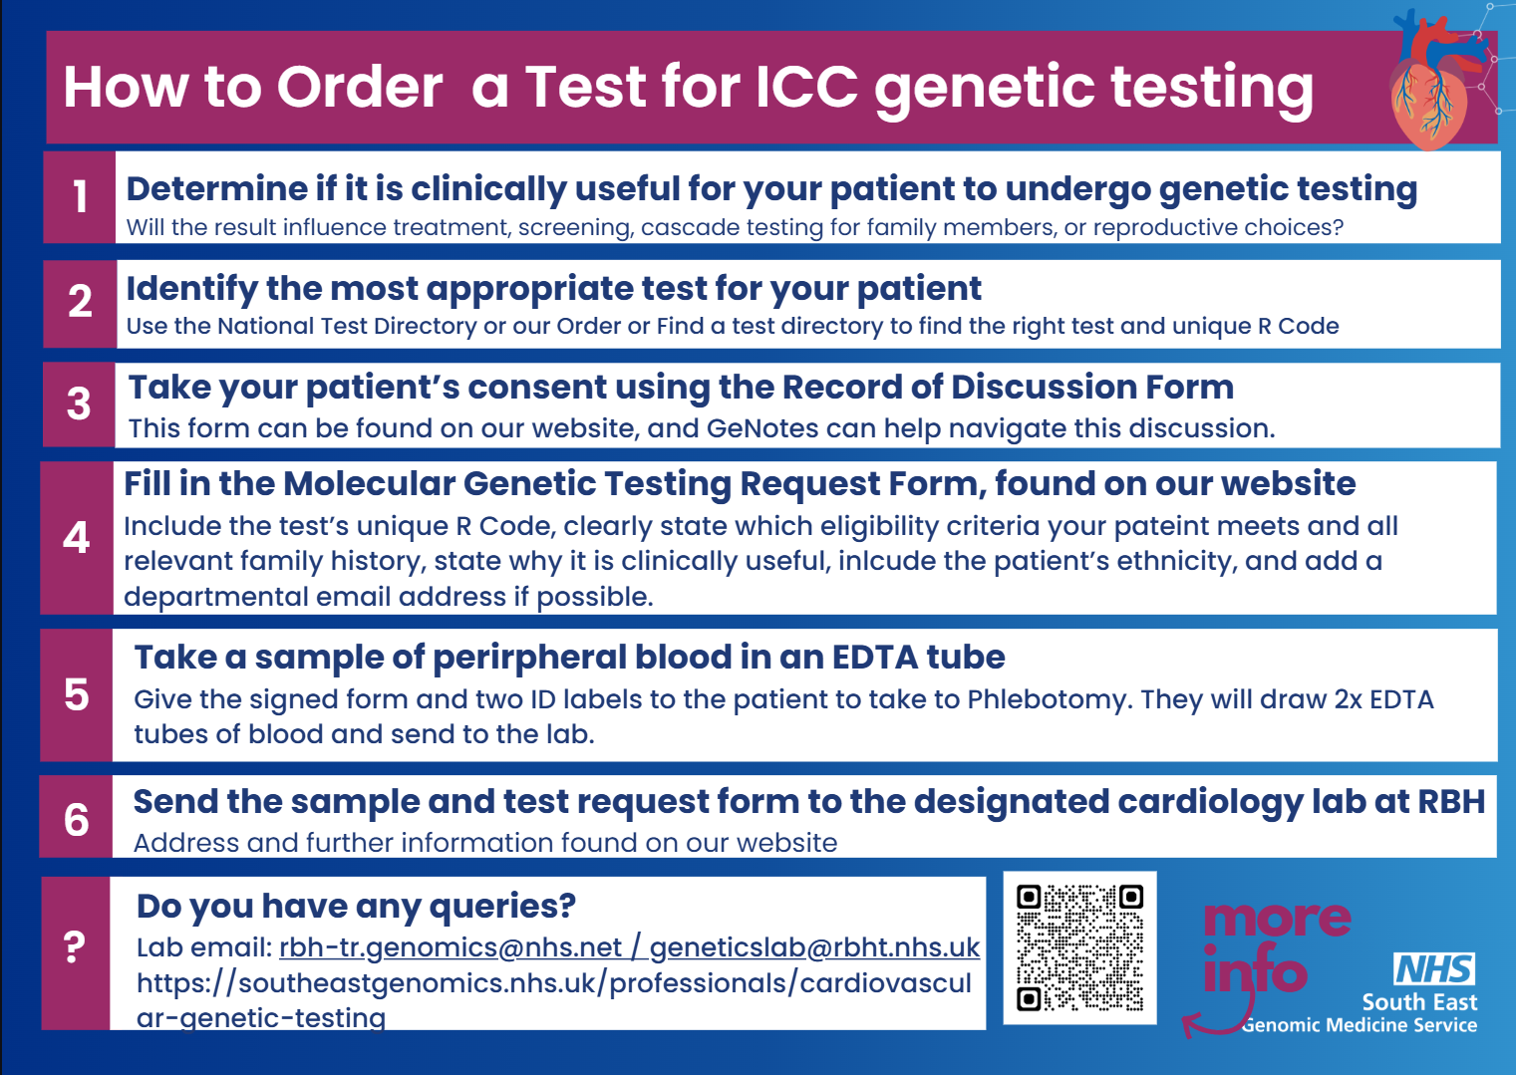
Request copies of our resources: nicky.scott7@.nhs.uk

Slide 22


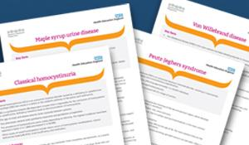
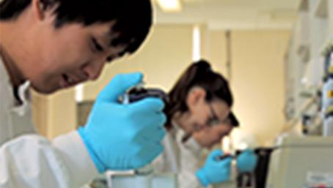

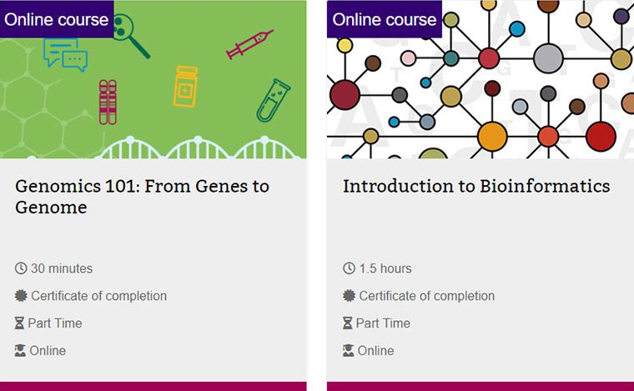
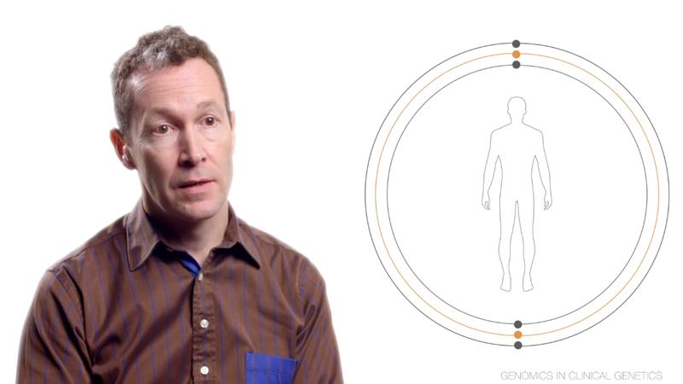
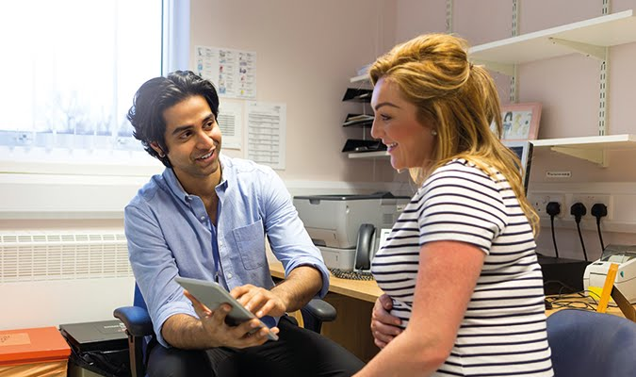
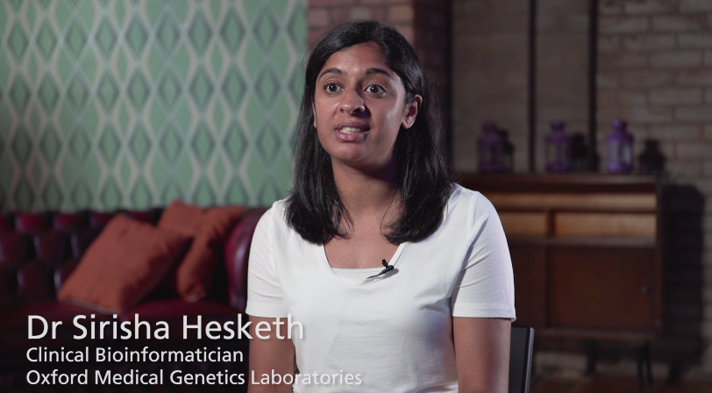
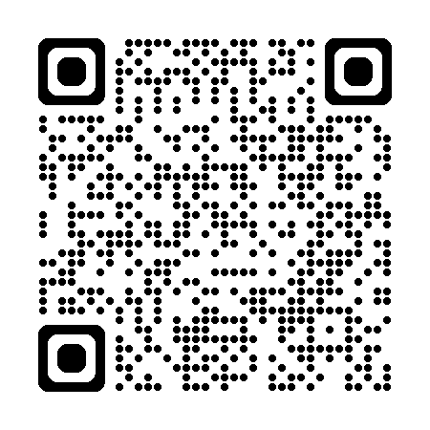


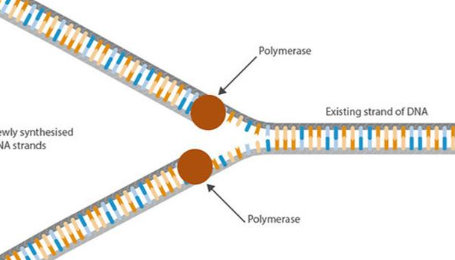

Genomics Education Programme
MSc in Genomic Medicine
MOOCs
Factsheets
Competency frameworks
Online courses
Medical specialties films
GeNotes
Expert films
Bitesize Genomics
Podcasts and blogs
Animations
#GenomicsConversation
www.genomicseducation.hee.nhs.uk @genomicsedu

Slide 23
Some useful resources
Our website
https://southeastgenomics.nhs.uk/
Order a test, find guidance and advice, find events
NHS England Genomics Education Programme
https://www.genomicseducation.hee.nhs.uk/
Bitesize learning, short courses, information on conditions
Our LinkedIn
https://www.linkedin.com/company/south-east-genomics/
Keep up to date with latest news, events and opportunities
Genomic Notes for Clinicians
https://www.genomicseducation.hee.nhs.uk/genotes/
Just-in-time concise resources on conditions and pathways
Whole Genome Sequencing (WGS) Resources
https://www.genomicsengland.co.uk/clinicians/resources
WGS forms and patient information leaflets
Sign up to our newsletter:
https://southeastgenomics.nhs.uk/contact/
Learn how to use genomics and make successful referrals

Slide 24

Any questions?
Get in touch
https://www.linkedin.com/company/south-east-genomics/
gst-tr.gtabsoutheastglh@nhs.net
Create Slido for second knowledge check and add QR code here
Slido.com XXXXXX

